Slide 1
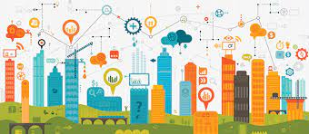
Digital transformation in business Examples
Companies with and without DT
Student 213110003

Slide 2
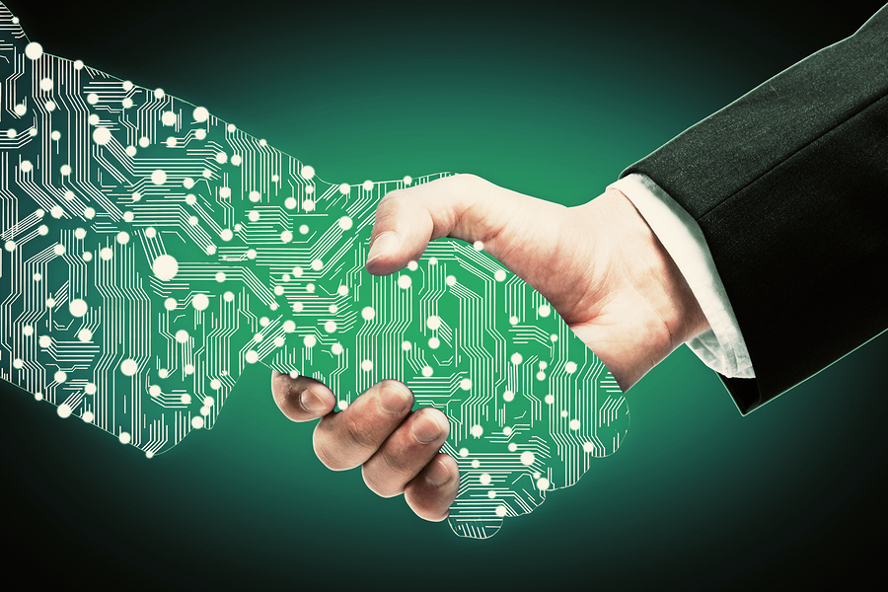
Digital Transformation
Digital transformation involves much more than the implementation of the digital technology.
Today companies are implementing transformation initiatives to gain time to market, stay competative, and optimize the customer experience.
The digital transformations efforts can be cathegorized into 3 types:
Organizations that are changing their products or services to become more digital.
Organizations that are embracing digital technology to change the way they engage with their customers.
Organizations that are transforming internal infrastructure to change the way they work.

Slide 3
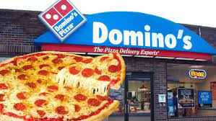
Notable examples of companies that achieved success in Digital Transformations
Domino`s pizza
After the collapse of the company in 2008, Domino`s has changed his menu and started to use the technolgy.
To give better services and products to his customers the company lunched Domino`s Tracker, last generation technology permitting customers to track their orders online.

Slide 4
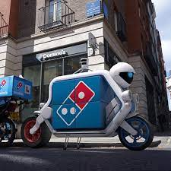
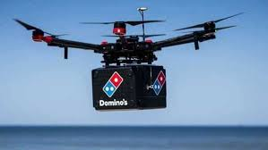
Domino`s pizza
They use autonomus vehicles and drones for pizza delivery
Today Domino`s AnyWare techology enables customers to order in more ways and on more devices.
The company has promoted the use of AI and Machine learning technology to improve product quality and enhance in-store and online operations.

Slide 5
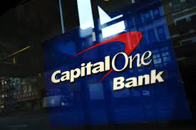
Capital Bank
The credit card giant in Virginia
In 2012 the Capital bank declared to offer a personilzed banking service in real time through the digital transformation.
Based on the modern technology the company used big data and machine learning to better understand customers
Embraced cloud computing
Implimented agile software development and DevOps, incl.the open source software.
In November 2020 it closed all its local data centers becoming the first bank to do it so, moving all applications and systems to Amazon Web Services
The cloud-first policy helped Capital one and its digital transformation team move away from infrastructure managment and focus on customer-centric innovation by using machine learning to turn data into insights.
All–in on digital

Slide 6
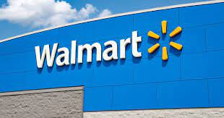
Walmart
In 2018 Walmart has put the digital transformation budjet of 11.700 millions $
To speed its transformation has partnered with Microsoft to capitalize on giant`s cloud computing power and scale its AI, machine learning and its data analytics initiatives.
Also partnered with Google for voice-enabled shopping.
Constantly investments from the supply chains to the sale, in the customer services, in the marketing, and in store operations
The digitizing Walmart`s supply chain is essential of its omnichannel strategy, which enables the company to serve customers through online, mobile and in-store interactions.
The retail giant

Slide 7
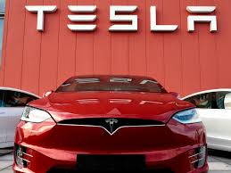
Tesla
Electric car manufacturer
Tesla has infused technology to all facets of the driving experience.
The Tesla cars receive software updates over the air
The success of Tesla:
Removed any middleman from the car-buying process
It uses extensive use of digital technoly to redefine the way the cars are built and driven
Constant approach to innovation
Through direct-to customer sales model has allowed Tesla to control the cutomer`s shopping experience.
In-house production – less costs and more innovation

Slide 8
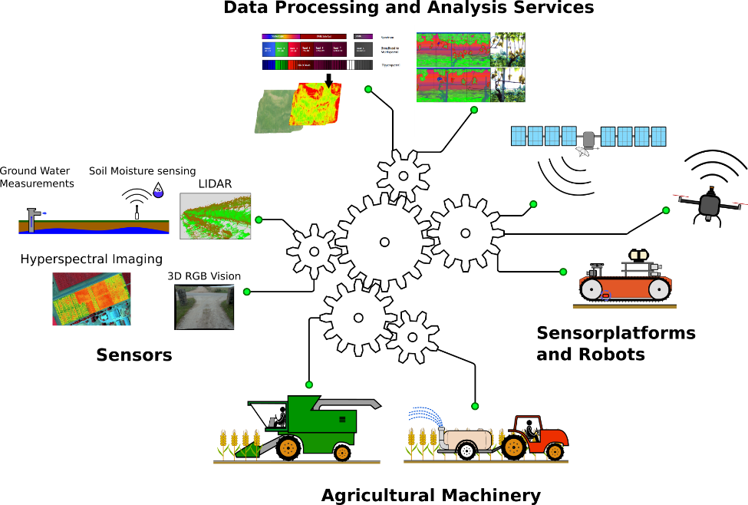
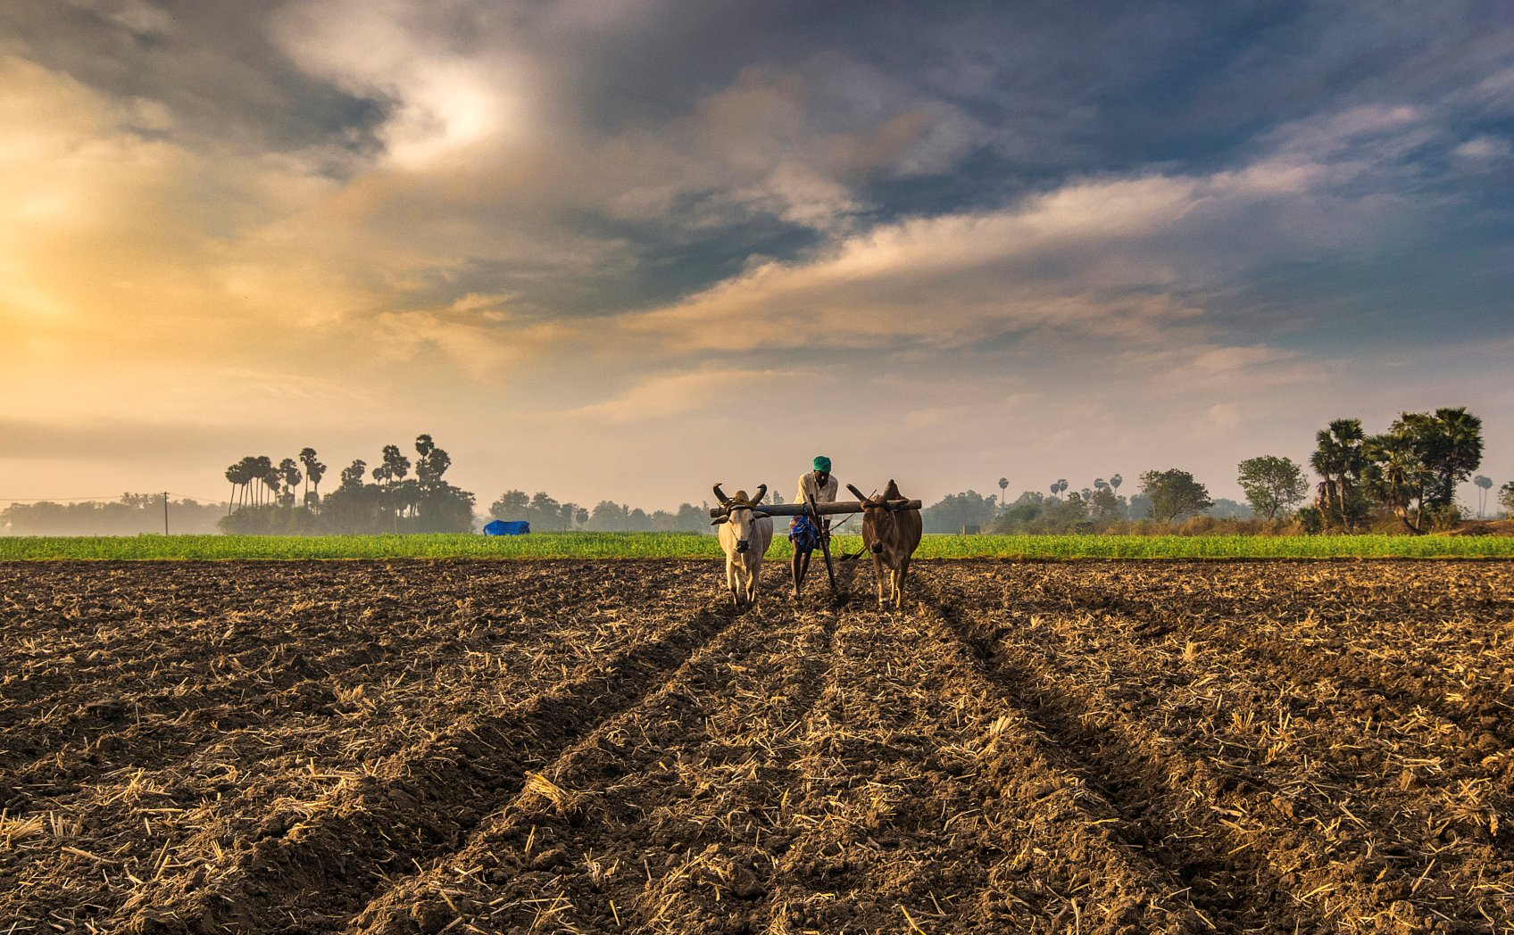

DT in agriculture or old business model
By rising the population in the world conventional production mechanisms have become absolete.
Automated systems in the form of sensor can control humidity, temp.,Ph, make more efficent decisions.
Agreculture technology makes phytosanitary monitoring that helps fight pests and weeds the moment they start to form.
Less waste of time and energy- thank you to cloud syncronization we can monitor the status of our crops in real time. We can configure alarm or sms when a critical variable is out of range,daily management reports,we can incorporate wheather forecast variable for irrigation scheduling.
Climate change = DT very valuable, to know exactly when a crop is attack by fungi, bacteria or virus,pesticid can be used only when needed rather then use constantly.
TrakitAgro,Atlas = DT platforms helping agriculture

Slide 9
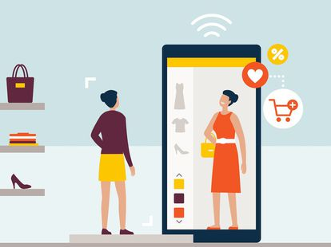
E-commerce or physical stores
Scedule
Physical shop- 8h; Online store 24/7
Global reach
Phys.shop- limited field, Online store seen by milions
Customers:
Online shop-you can obtain more info about behaviour and preferences(Google Analytics),you can have statistics of number of visits,which products are seen more, which countries visit your web,etc…= Help improve your web and products.
Managment in Online store simlpier, do from anywhere from the world,no physical presence.Woocommerce to manage your store easily
More variety and quantity-buying from suppliers once customer make the payment of the order, you only need photos, a description of the product and be clear with delivery times.
Most of customer after visit phys. Shop goes to the online version; no web page-lost clients..
Attractive web site,good cutomer service = less costs for advartising, thanks to social networks-easy buzz marketing. Our cutomers will recommend us to their family, friends without investing in ads.

